Slide 1
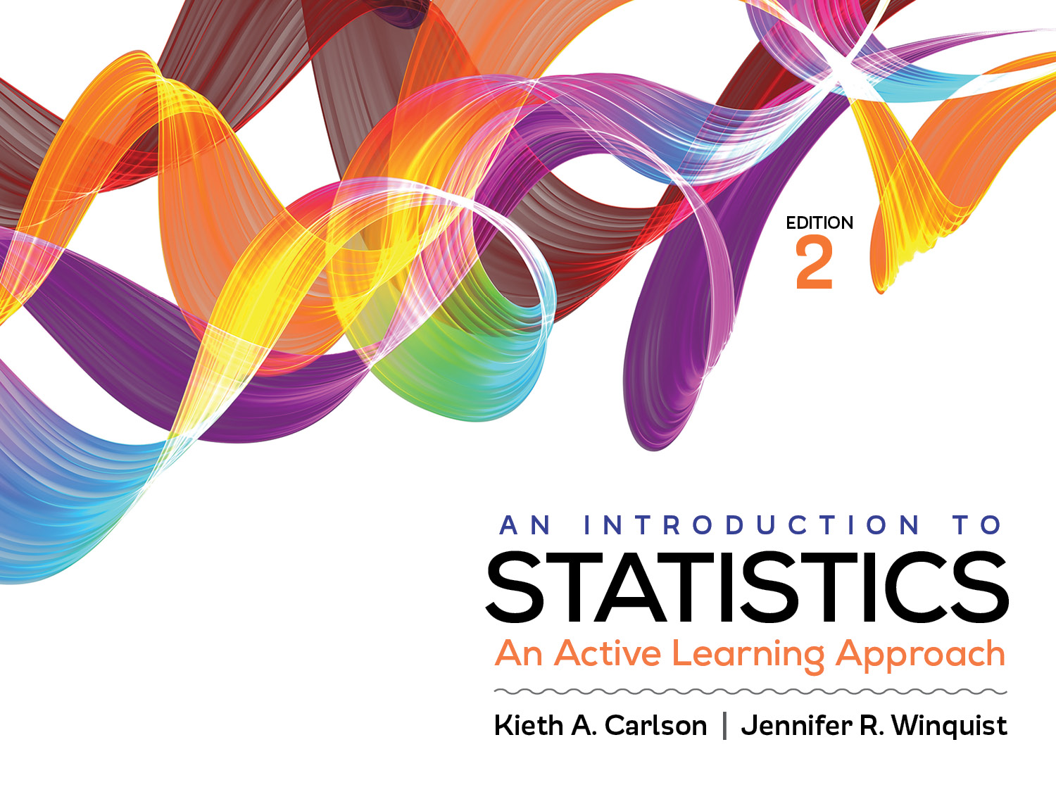
Introduction to Activity 6.1
Introduction to Hypothesis Testing

Slide 2
Activity 6.1 will require you to:
Conduct a hypothesis test using the z for a sample mean
Assess the assumptions of a z for a sample mean
State null and research hypotheses
Define the critical region
Compute the z for the sample mean
Compute and interpret the effect size
Identify Type I Error, Type II Error, and Statistical Power on the appropriate distribution of sample means curves

Slide 3
Logic of hypothesis testing
M = ? If the treatment does NOT work, we expect the M to equal ______. Any difference between µ and M would be caused by _______ _______ .
Research question: Does drug treatment increase memory scores?
TREATMENT
Population: µ = 80; σ = 10
Sample N = 100
M = ? If the treatment DOES work, we expect the M to equal _______________. The difference between µ and M would be caused by the ______________ .
Notes:
If the treatment does NOT work, we expect M = 80 (population mean); any difference would be created by sampling error.
If the treatment does work, we expect M to be greater than 80 (don’t know exactly how much greater); difference would be created by the treatment.

Slide 4
1. Assumptions
Independence of data
Each person’s scores are independent of other participants’ scores
Appropriate measurement of the IV and DV
IV identifies a group of people that are different from the population in some way
DV measured on an interval/ratio scale
Normality of distributions
Distribution of sample means is normal
Homogeneity of variance
Variance in the sample is similar to the variance in the population

Slide 5
2. Null and research hypotheses
Null (H₀) = µ_{T} ≤ 80
If entire population were treated, the mean would be equal or less than 80 (what it is now).
It is saying the treatment will not work; it won’t change anything.
It is saying any difference between the means (sample mean and population mean) is due to sampling error.
Research (H₁) = µ_{T} > 80
If the entire population were treated, the mean would be greater than 80 (what it is now).
It is saying the treatment will work; it will increase scores.
It is saying any difference between the means (sample mean and population mean) is due to the treatment

Slide 6

3. Define the critical region
Distribution of sample means if the null hypothesis is true
Normal, Mean = 80, Standard deviation 10, N = 100;
so SEM = $σ/{\sqrt{N}}= {10}/{\sqrt{100}}=1$
1.65 or higher is the critical region
Reject H₀ if obtained z is in the critical region; Fail to reject H₀ if outside the critical region

Slide 7
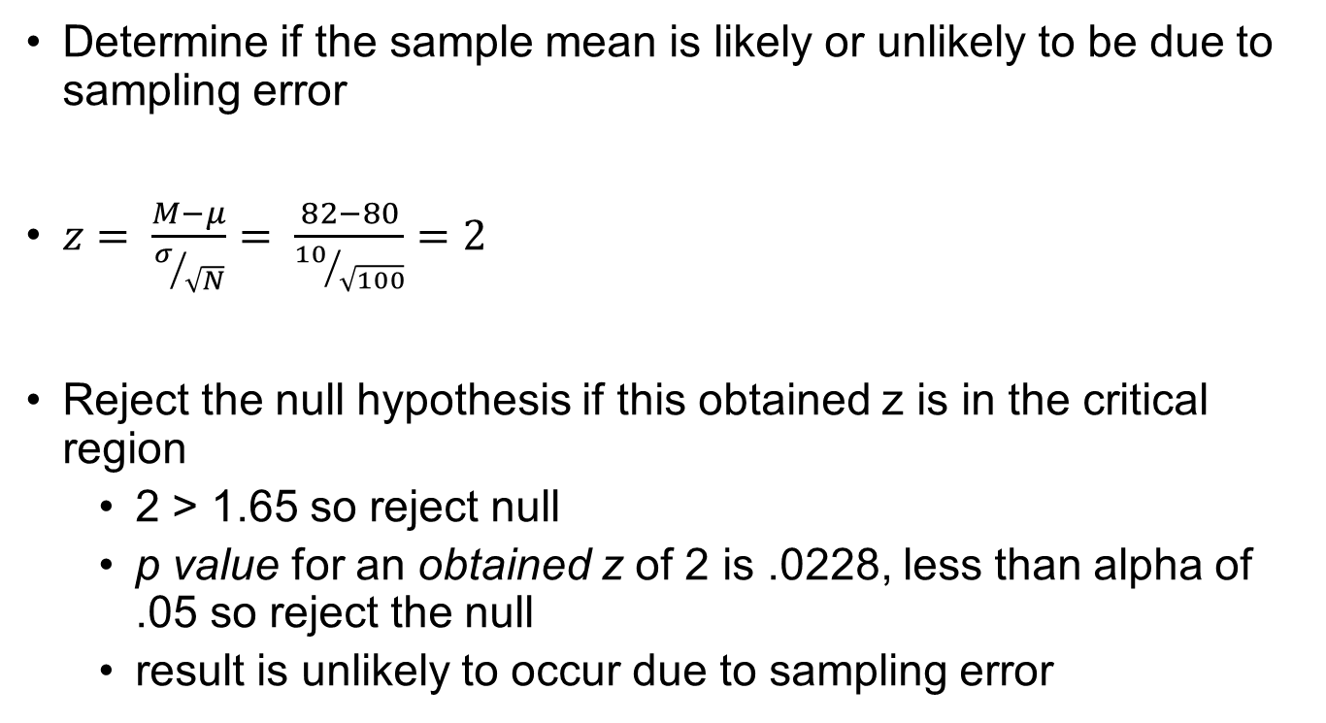
4. Compute the test statistic
Determine if the sample mean is likely or unlikely to be due to sampling error
$z= \frac{M−μ}{σ/{\sqrt{N}}}= \frac{82−80}{{10}/{\sqrt{100}}}=2$
Reject the null hypothesis if this obtained z is in the critical region
2 > 1.65 so reject null
p value for an obtained z of 2 is .0228, less than alpha of .05 so reject the null
result is unlikely to occur due to sampling error
1.65 or higher is the critical region

Slide 8
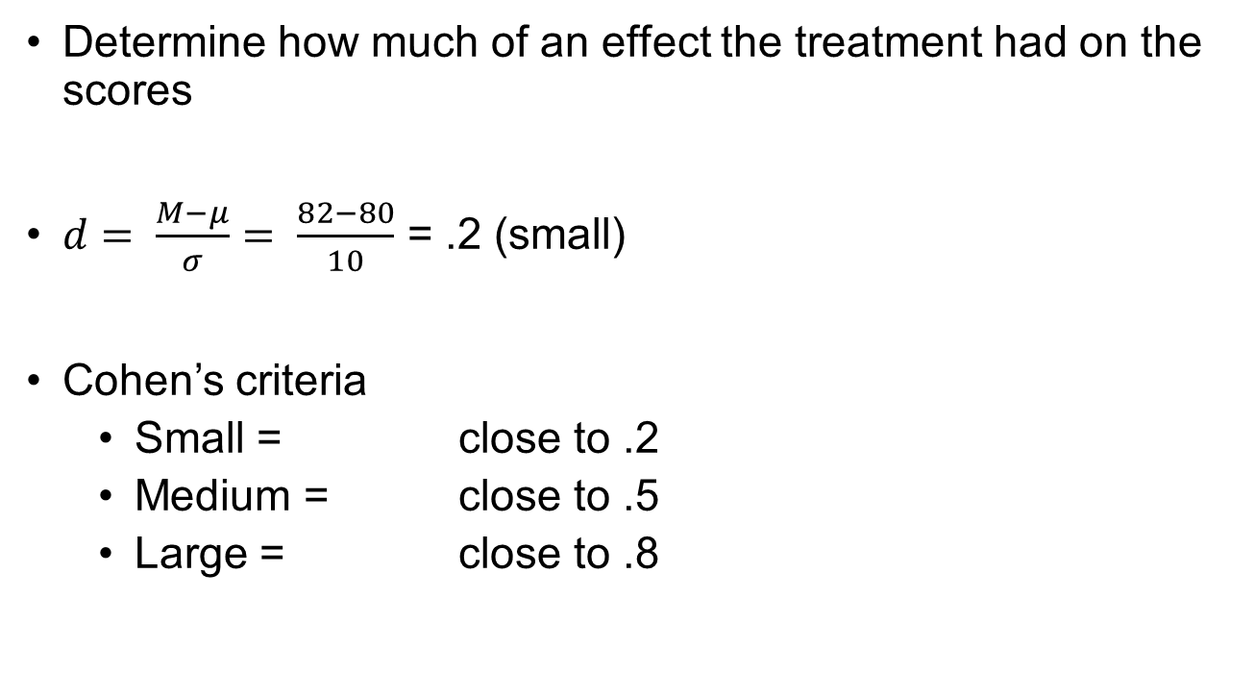
5. Compute the effect size
Determine how much of an effect the treatment had on the scores
$d= \frac{M−μ}{σ}= \frac{82−80}{10}$ = .2 (small)
Cohen’s criteria
Small = close to .2
Medium = close to .5
Large = close to .8

Slide 9
6. APA Style Summary
The drug treatment mean (M = 82, SD = 10) was significantly higher than the population mean (µ = 80), z (N = 100) = 2.00, p = .02, d = .20. Although the treatment was effective, it only improved memory by a small amount.
In APA style you report data to the second decimal
Give the exact p value if possible.
say p < .05 (or p > .05) if you do not know the exact p value.

Slide 10
Errors and statistical power
Type I error—incorrectly saying a treatment works
Type II error—incorrectly saying a treatment does not work
Statistical power—correctly saying a treatment works
Near the end of this activity you will try to locate these concepts on the null hypothesis distribution of sample means or the research hypothesis distribution of sample means.
On which distribution would a Type I error go?
On which distribution would a Type II error go?
On which distribution would Statistical Power go?
Notes:
On which distribution would a Type I error go? Null Curve
On which distribution would a Type II error go? Research Curve
On which distribution would Statistical Power go? Research Curve

